Slide 1
National Census of Ferry Operators (NCFO) Ferry Route Visualization Andrew Barrows, Alberto Nieto, Dominic Menegus Bureau of Transportation Statistics ESRI Federal Conference March 20-21, 2018

Slide 2
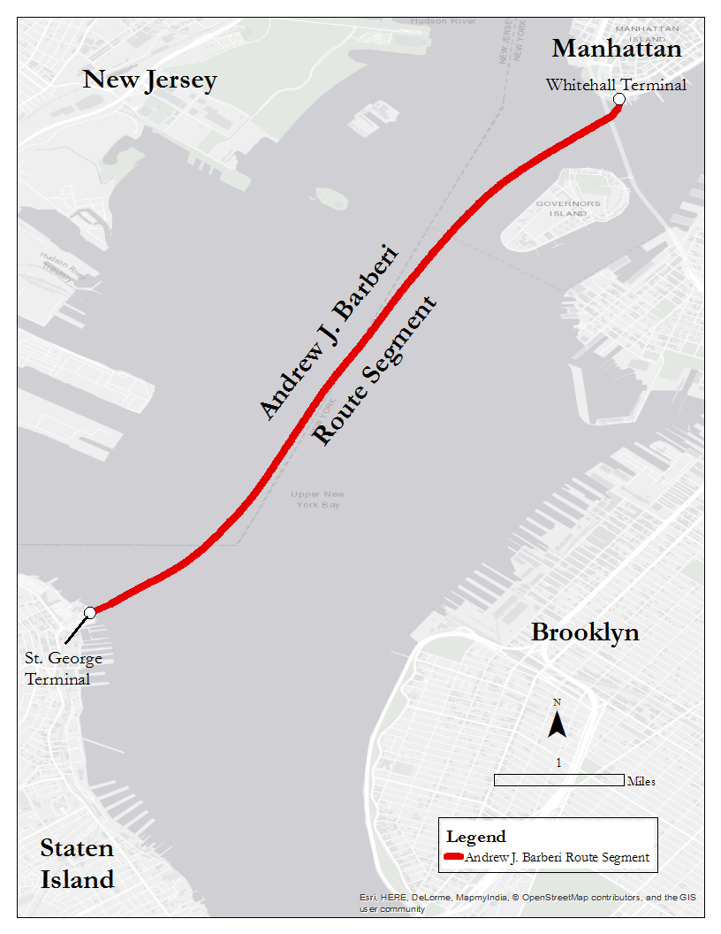

NCFO Specifics
Every two years OSP conducts a new National Census of Ferry Operators (NCFO)
2016 NCFO was released in Oct, 2017
What is a considered a segment?

Slide 3
Visualizing NCFO Data
The 2016 NCFO’s data was recently released by BTS, but segment data remains largely in excel format
Purpose of project:
Find a way to visualize NCFO segment data, particularly a process that can be automated
Eventually design and implement a geospatial web tool that will allow the user to interact with segment data
Use the final tool to calculate segment distances for verification against reported values

Slide 4
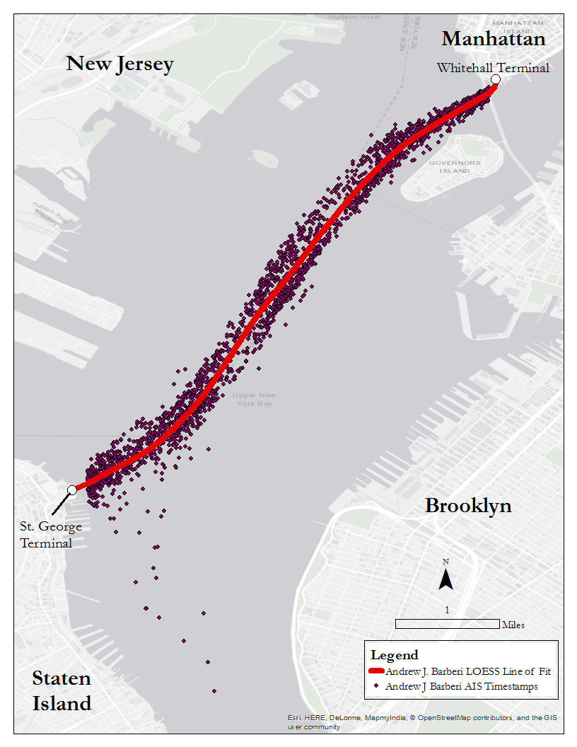
Is AIS Data the Answer?
AIS = automatic identification system
AIS data exists for many types of vessels
Data format and source:
5 minute data collection intervals taken over a one month period
USACE

